Slide 1
Financial Analytics

Slide 2
Introduction
In the fast-paced and dynamic business environment, understanding the competitive landscape
is paramount for companies striving to thrive and excel. To this end, management has tasked us
with analyzing the competition to glean valuable insights that can lead to improved results and
strategic decision-making. Our analysis focuses on a dataset encompassing information on the
market capitalization of the top 500 companies in India, along with their quarterly sales figures.

Slide 3
Quick Insight
488
Total Company
28.06K
Average MarCap

Slide 4
Main KPIs
Total Company – Total number of company
Average MarCap – Average of market capital of companys
Market Cap By Q-Sale – Market capital according to Quatrly Sales
Company by MarCap – Company names according to there Market Capital
Total Sales by MarketCap – Total sales of company by market capital

Slide 5
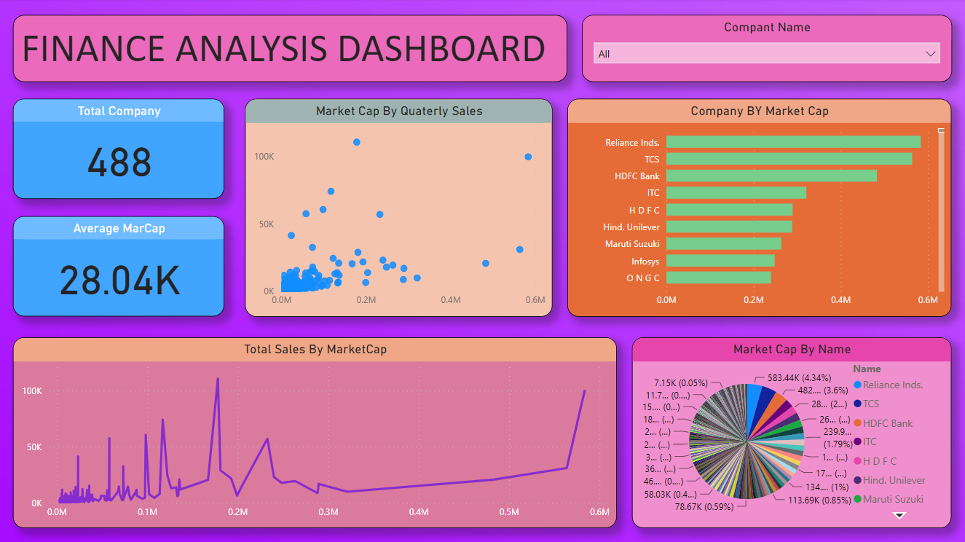
Dashboard

Slide 6
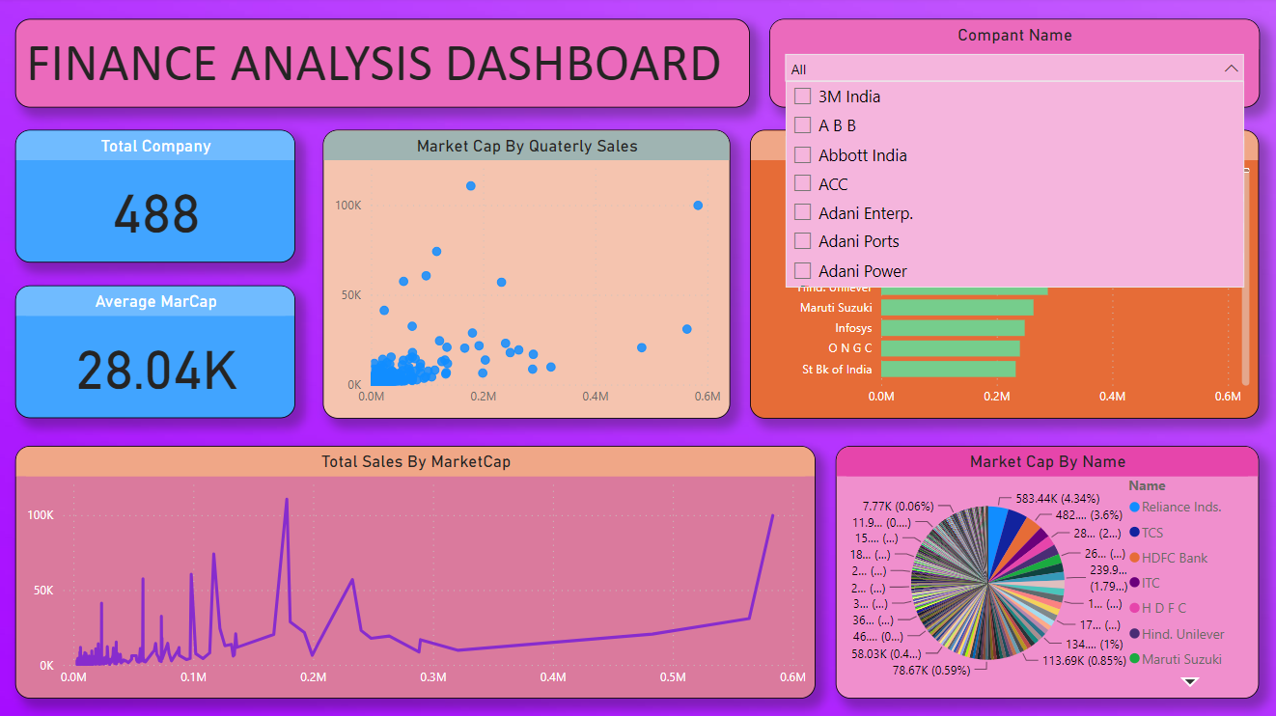
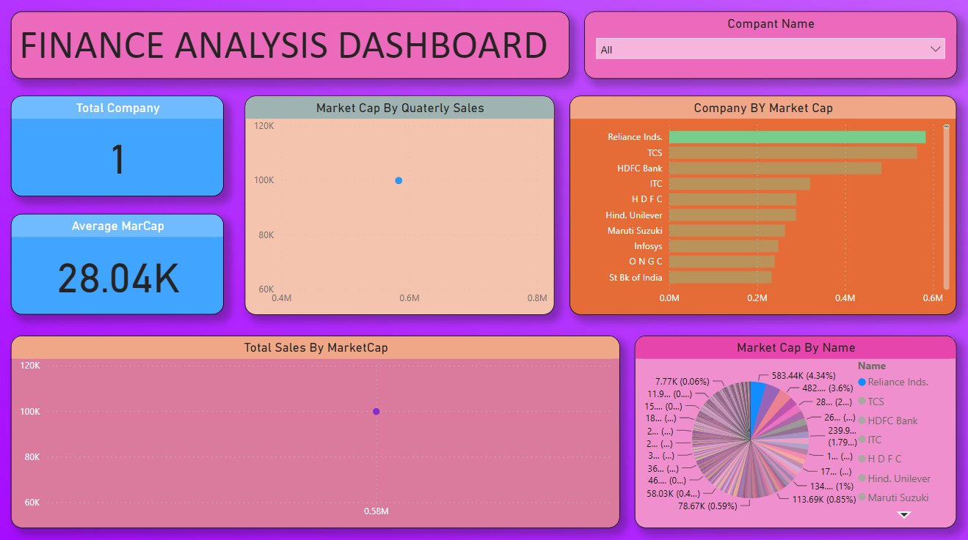
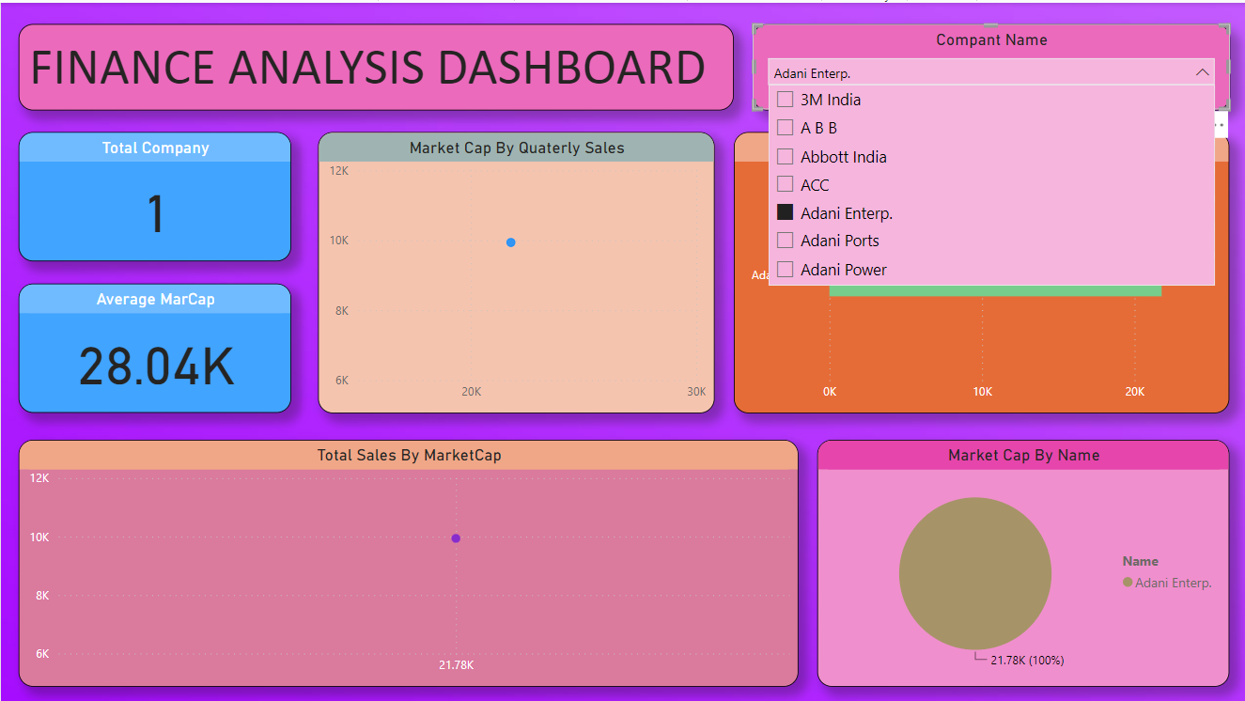
Working Dashboard

Slide 7
Thank you

